Slide 1

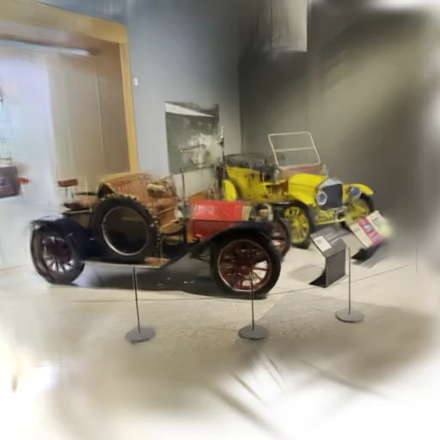
4th Stage Review Meeting
ETH - Huawei

Slide 2
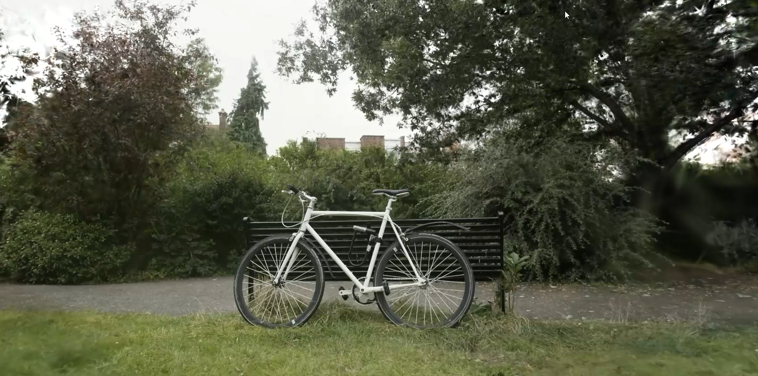
3D Gaussian Splatting – SIGGRAPH 2023

Slide 3
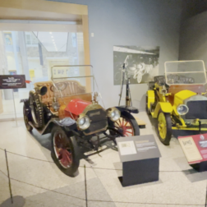
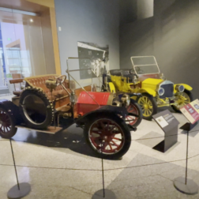
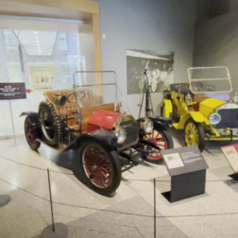
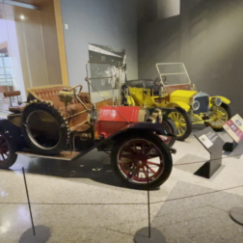
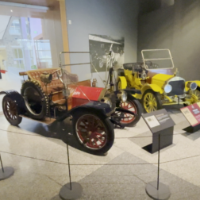
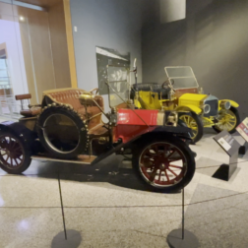
What if you want the capture in < 1 sec and only have a few images?
???

Slide 4
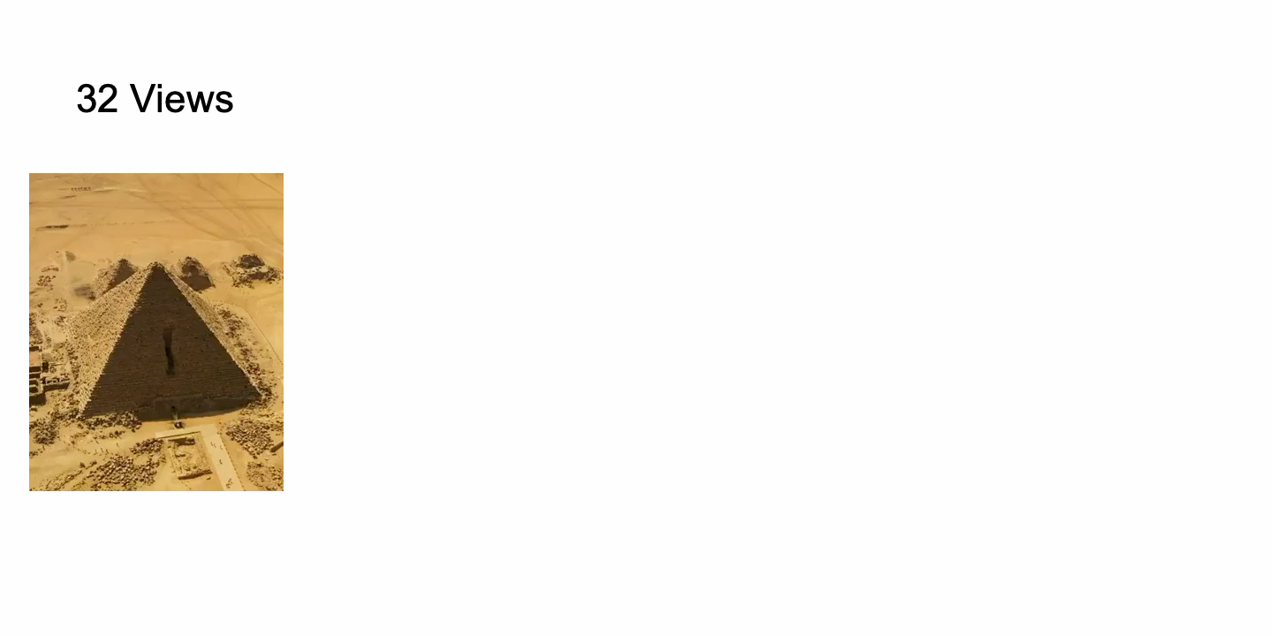
Strong progress in feed forward reconstruction, can we reuse them?
VGGT – CVPR25

Slide 5
What if you want the capture in < 1 sec and only have a few images?
???

Slide 6


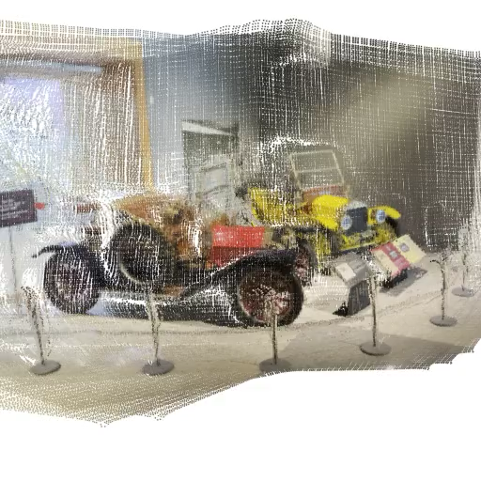
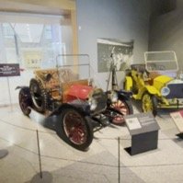

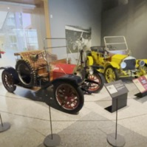

Strong progress in feed forward reconstruction, can we reuse them?
Multi-View Input
Multi-View Backbone
Visual Tokens
Per Pixel Depth / Points
+ Gaussian Params

Slide 7
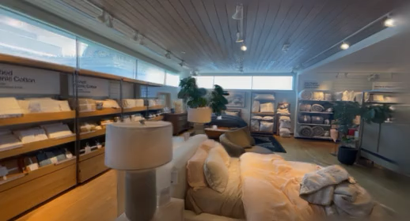
These methods have achieved quite high quality.
YoNoSplat – ICLR26

Slide 8
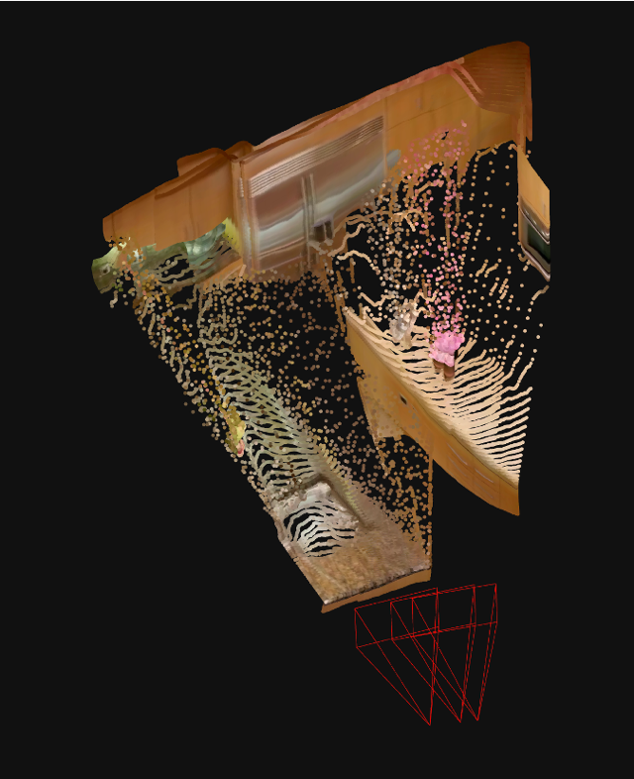
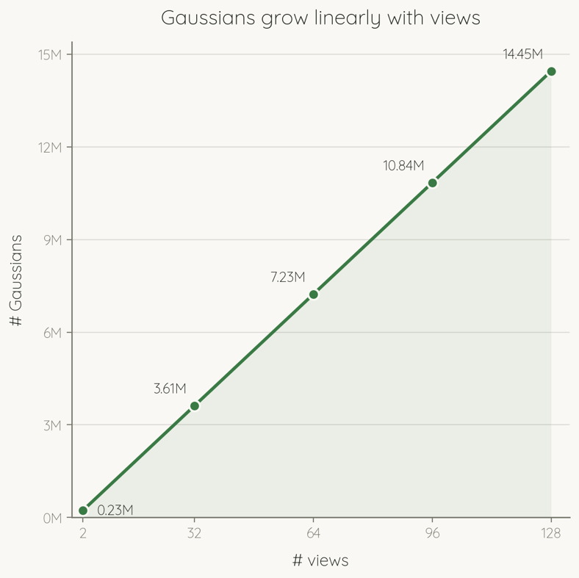
The issues with per pixel predictions.
252x448 px
Small pose error = clear artifacts

Slide 9
So what can we do about it?
What we want:
Solve the sensitivity to pose and depth errors
Solve the redundancy of overlapping pixels

Slide 10
Can we do better?
Multi-View Input
Multi-View Backbone
Visual Tokens
Per Pixel Depth / Points
+ Gaussian Params

Slide 11
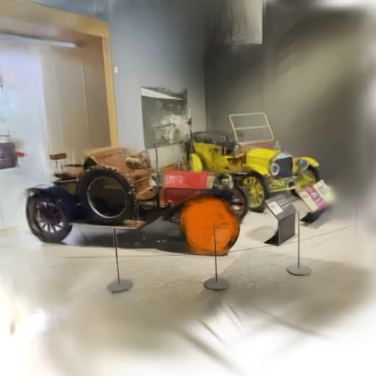
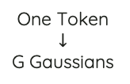
Can we do better?
Multi-View Input
Multi-View Backbone
Visual Tokens
MLP
One Token
$$↓$$
G Gaussians

Slide 12






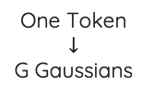
Initial Idea: have a learned, fixed set of gaussian queries.
Gaussian
Reconstruction
Multi-View Backbone
Visual Tokens
Token Aggregation
x L
K,V
Cross - Attention
Self - Attention
Multi-View Input
z
MLP
One Token
$$↓$$
G Gaussians
Q

Slide 13
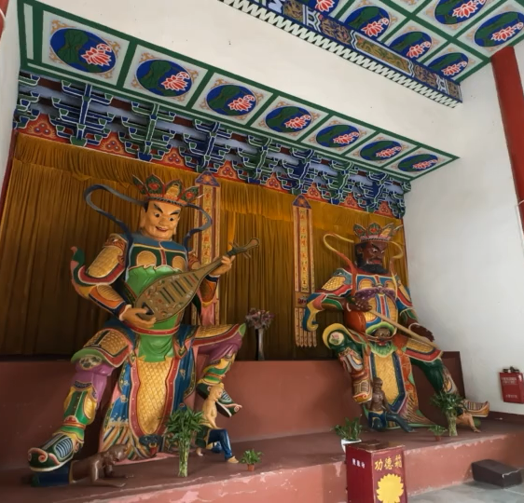
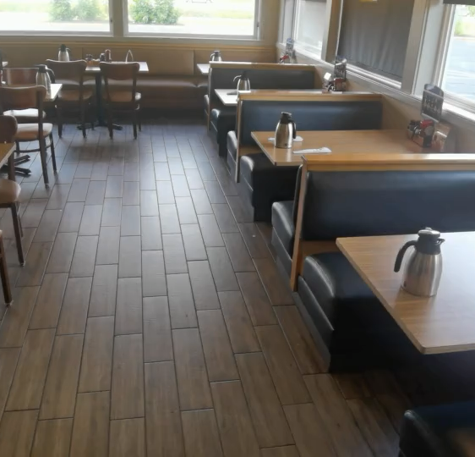
The Fundamental Limitation: scenes complexities are different!
Require very different
Gaussian Counts

Slide 14
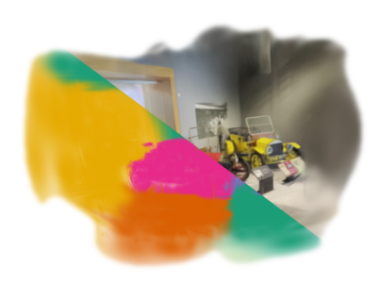

ZipSplat: Fewer Gaussians, better Splats
Gaussian
Reconstruction
ZipSplat
Multi-View Backbone
T Visual Tokens
Token Aggregation
x L
K,V
Cross - Attention
Self - Attention
Multi-View Input
z
MLP
One Token
$$↓$$
G Gaussians
K-Means
Q
??
Compression r
$$K=r⋅T$$
efficiency
quality

Slide 15
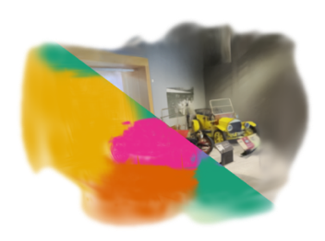

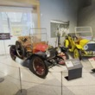
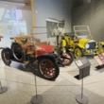





ZipSplat: Fewer Gaussians, better Splats
ZipSplat
Gaussian
Reconstruction
Multi-View Backbone
T Visual Tokens
Token Aggregation
x L
K,V
Cross - Attention
Self - Attention
Multi-View Input
z
MLP
One Token
$$↓$$
G Gaussians
K-Means
Q
Compression r
$$K=r⋅T$$
efficiency
quality
+ 2.1 PSNR
33x fewer
Gaussians
PSNR
Number of Gaussians

Slide 16
ZipSplat: Fewer Gaussians, better Splats
ZipSplat
Gaussian
Reconstruction
Multi-View Backbone
T Visual Tokens
Token Aggregation
x L
K,V
Cross - Attention
Self - Attention
Multi-View Input
z
MLP
One Token
$$↓$$
G Gaussians
K-Means
Q
Compression r
$$K=r⋅T$$
efficiency
quality
Free 3D Gaussian placement, decoupled from the pixel grid
Continuous quality / efficiency trade-off via latent k-means with one model, no retraining
Pose-free SOTA with 6x fewer Gaussians for in- and out-of-domain benchmarks
+ 2.1 PSNR
33x fewer
Gaussians
PSNR
Number of Gaussians

Slide 17
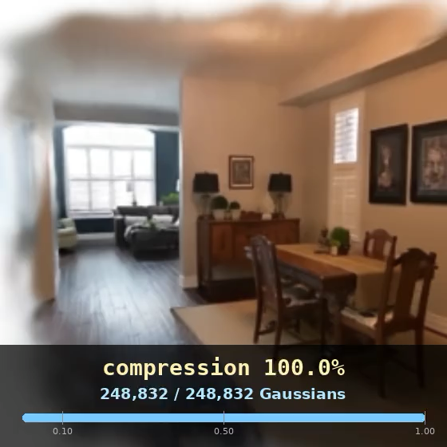
ZipSplat spans the whole quality-efficiency curve.
+ 2.1 PSNR
33x fewer
Gaussians
PSNR
Number of Gaussians

Slide 18

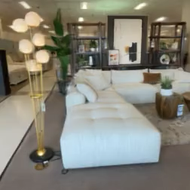
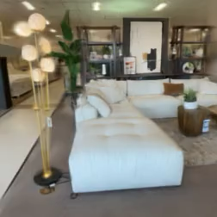
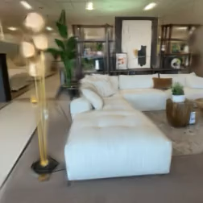
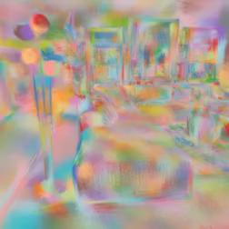
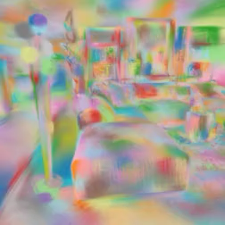
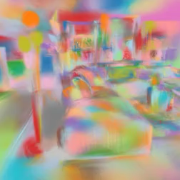

Tokens self-organize in 3D.
z
MLP
One Token
$$↓$$
G Gaussians
No Compression
2x Compression
4x Compression
Novel Views
Token Visualization
Each token learns to own a patch of 3D:
large groups on walls, compact groups on fine detail

Slide 19
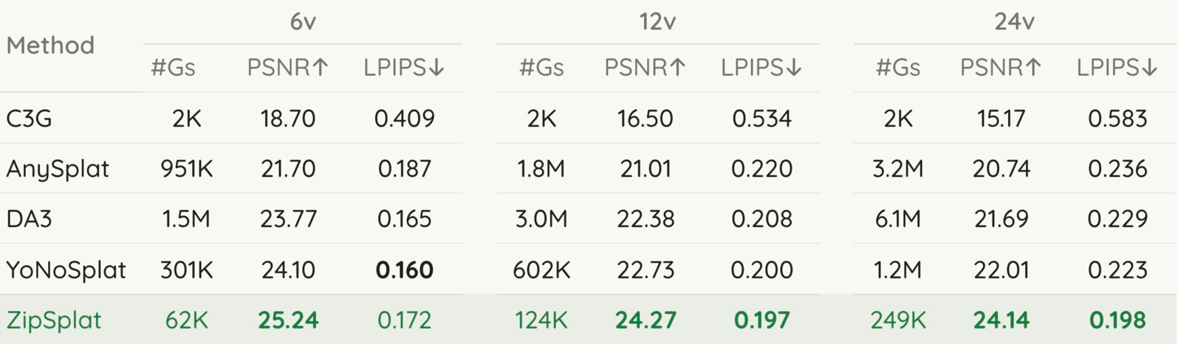
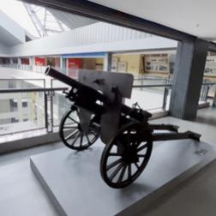
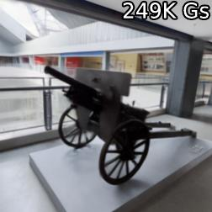
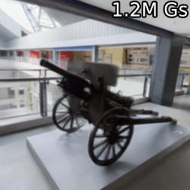
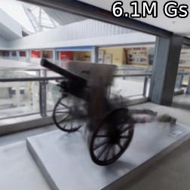
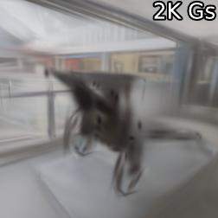
Beats pixel-aligned methods using > 5x fewer Gaussians
24 views
GT
ZipSplat
YoNoSplat
DA3
C3G

Slide 20
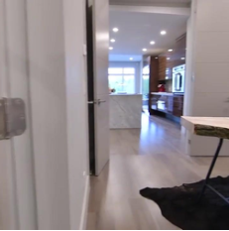
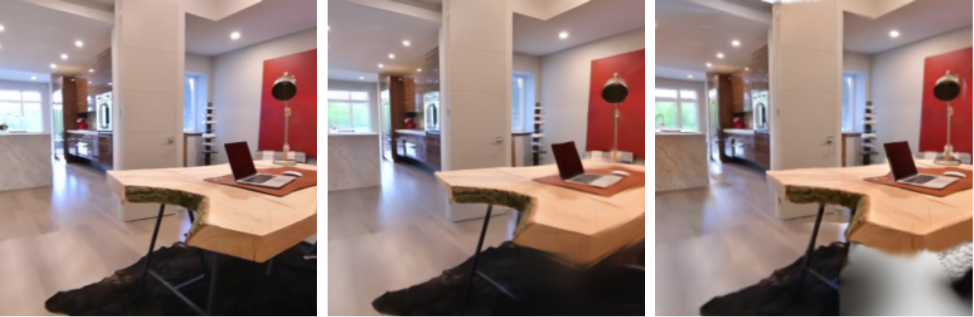
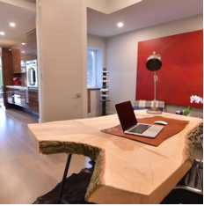
Free placement extends Gaussians into unobserved regions.
GT
ZipSplat
AnySplat
Input Views
…

Slide 21
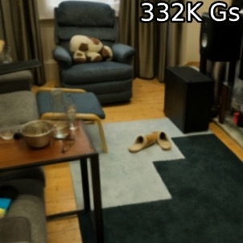
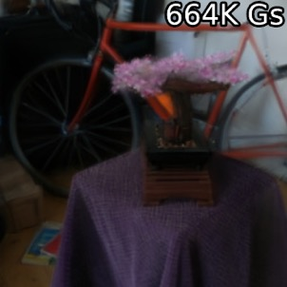
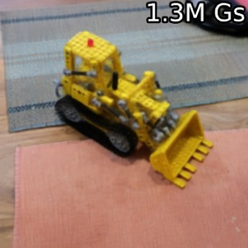
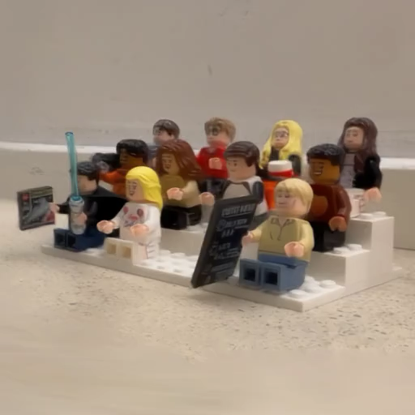
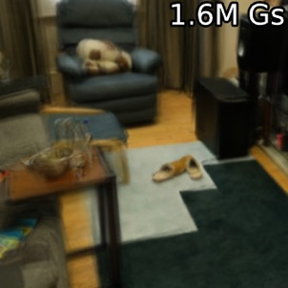
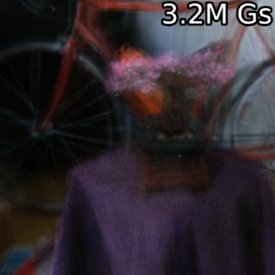
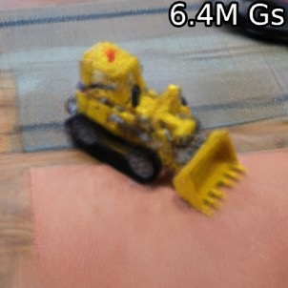
Generalizes zero-shot to unseen domains
Mip-NeRF360 (zero-shot)
fully out of distribution
ZipSplat
YoNoSplat
32 Views
64 Views
128 Views

Slide 22
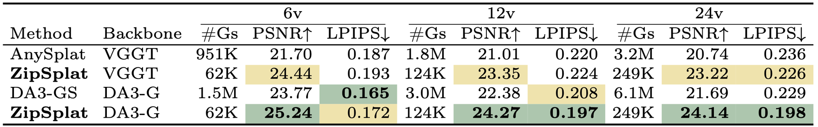
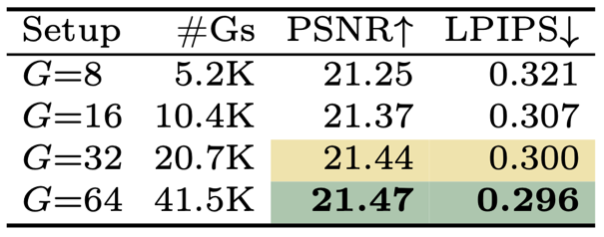
Ablations
Backbone Ablation: ZipSplat beats baselines at matched backbones
#GS Ablation (da3s – 2 views)

Slide 23
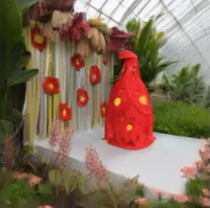


How can we further improve the model?
How can we refine the predicted gaussians?
How can learn good features for clustering?
Input Views
PCA on Tokens

Slide 24
Per Pixel methods seem to have a benefit in LPIPS
24 views
GT
ZipSplat
YoNoSplat
DA3
C3G

Slide 25

Optimizing tokens at test time: +5.7 PSNR on DL3DV in 1-3 sec
ZipSplat
Gaussian
Reconstruction
Multi-View Backbone
T Visual Tokens
Token Aggregation
x L
K,V
Cross - Attention
Self - Attention
Multi-View Input
z
MLP
One Token
$$↓$$
G Gaussians
K-Means
Q
Compression r
$$K=r⋅T$$
efficiency
quality

Slide 26

Optimizing tokens at test time: +5.7 PSNR on DL3DV in 1-3 sec
ZipSplat
Gaussian
Reconstruction
Multi-View Backbone
T Visual Tokens
Token Aggregation
x L
K,V
Cross - Attention
Self - Attention
Multi-View Input
z
MLP
One Token
$$↓$$
G Gaussians
K-Means
Q
Compression r
$$K=r⋅T$$
efficiency
quality

Slide 27

Test Time Optimization 🤝🏼 Pose Alignment
Good Gaussians => Good Alignment
Token Test Time Optimization
Pose Alignment
Good Alignment => Good TTO

Slide 28

Alternating TTO and pose alignment improves the pose a lot
+ 25 AUC@3

Slide 29

… and reconstruction as well
+ 4.5 PSNR

Slide 30


Slide 31


Slide 32
How can we further improve the model?
How can we refine the predicted gaussians?
How can learn good features for clustering?
Input Views
PCA on Tokens

Slide 33








How can learn good features for clustering?
Input Views
ZipSplat
Multi-View Backbone
T Visual Tokens
Token Aggregation
x L
Multi-View Input
K,V
Cross - Attention
Self - Attention
z
MLP
One Token
$$↓$$
G Gaussians
K-Means
Q
Compression r
$$K=r⋅T$$
efficiency
quality
PCA on Tokens
PCA

Slide 34


How can learn good features for clustering?
Input Views
Similarity
PCA on Tokens

Slide 35



Features that correspond to the same 3D location should be similar
Input Views
3D Kernel
Patch Kernel

Slide 36


Adding this loss makes the PCA a lot more structured
Input Views
Similarity
PCA on Tokens
+NCE

Slide 37


Training with this loss makes compression more robust
With NCE
w/o NCE
Custers spread more across views

Slide 38

Taking all updates together, the model improved at lot
r=0.03

Slide 39

Taking all updates together, the model improved at lot

Slide 40



Taking all updates together, the model improved at lot

Slide 41
ZipSplat: Fewer Gaussians, better Splats
ZipSplat
Gaussian
Reconstruction
Multi-View Backbone
T Visual Tokens
Token Aggregation
x L
K,V
Cross - Attention
Self - Attention
Multi-View Input
z
MLP
One Token
$$↓$$
G Gaussians
K-Means
Q
Compression r
$$K=r⋅T$$
efficiency
quality
Free 3D Gaussian placement, decoupled from the pixel grid
Continuous quality / efficiency trade-off via latent k-means with one model, no retraining
Pose-free SOTA with 6x fewer Gaussians for in- and out-of-domain benchmarks
+ 2.1 PSNR
33x fewer
Gaussians
PSNR
Number of Gaussians

Slide 42


Outlook: Dynamic Extension of ZipSplat (WP5)
Casual Video -> 4D Reconstruction
Shape Of Motion – ICCV25

Slide 43

Outlook: Dynamic Extension of ZipSplat (WP5)
ZipSplat
Gaussian
Reconstruction
Multi-View Backbone
T Visual Tokens
Token Aggregation
x L
K,V
Cross - Attention
Self - Attention
Multi-View Input
z
MLP
One Token
$$↓$$
G Gaussians
K-Means
Q
Compression r
$$K=r⋅T$$
efficiency
quality
2 Main Questions:
How to predict the dynamics per gaussians?
Arch. Changes, robustness vs expressivity of motion, …
How to learn the static/dynamic decomposition?
Gate motion on this, can we it learn without GT?

